Slide 1
Network Security
CSC 481/681/781
Principles of Computer Security
Reference: Goodrich and Tamassia, Chapter 5

Slide 2
Networking Overview
Purpose: Allow computers and devices to talk to each other
Why:
Sharing data: file servers, database servers, …
Sharing devices: printers, CPUs (grid computing), ...
Since when?
Internet dates back to ARPANET experiments in late 1960’s
Phone line/modem connections from early 1960’s
Ethernet from mid 1970’s
Changing dynamics:
Past: Data over voice networks
Now: Voice over data networks

Slide 3
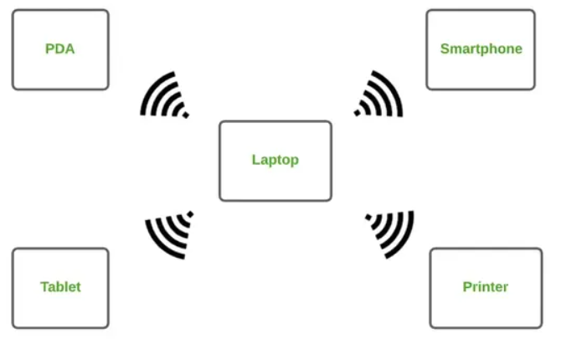
Types of Networks Classified by size/geographical area
Also (we won’t talk about this though):
PAN: Personal Area Network
Coverage Range: 1–10 meters
Key Technologies: Bluetooth, NFC, Infrared
Real-World Example: Smartphone connected to wireless earbuds
When It Is Used: For short-range communication between personal devices

Slide 4
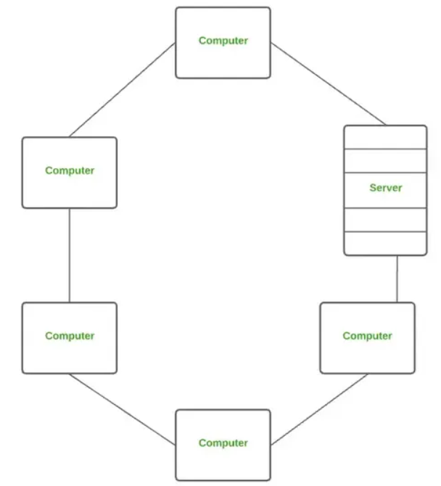
Types of Networks Classified by size/geographical area
LAN: Local Area Network
Localized (room, building, cluster of buildings)
High speed
Key Technologies: Ethernet, Wi-Fi
Real-World Example: Home or office Wi-Fi network
When It Is Used: For fast and secure communication within a local location

Slide 5
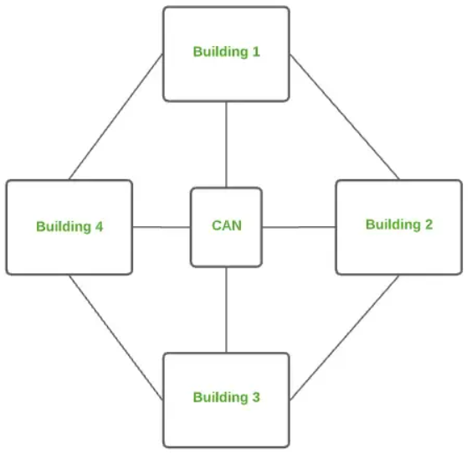
Types of Networks Classified by size/geographical area
Also (we won’t talk about this though):
CAN: Campus Area Network
A CAN connects multiple LANs within a campus or a group of nearby buildings.
Coverage Range: University or corporate campus
Key Technologies: Ethernet, Fiber Optics
Real-World Example: College or corporate campus network
When It Is Used: To interconnect LANs across a campus under one organization

Slide 6
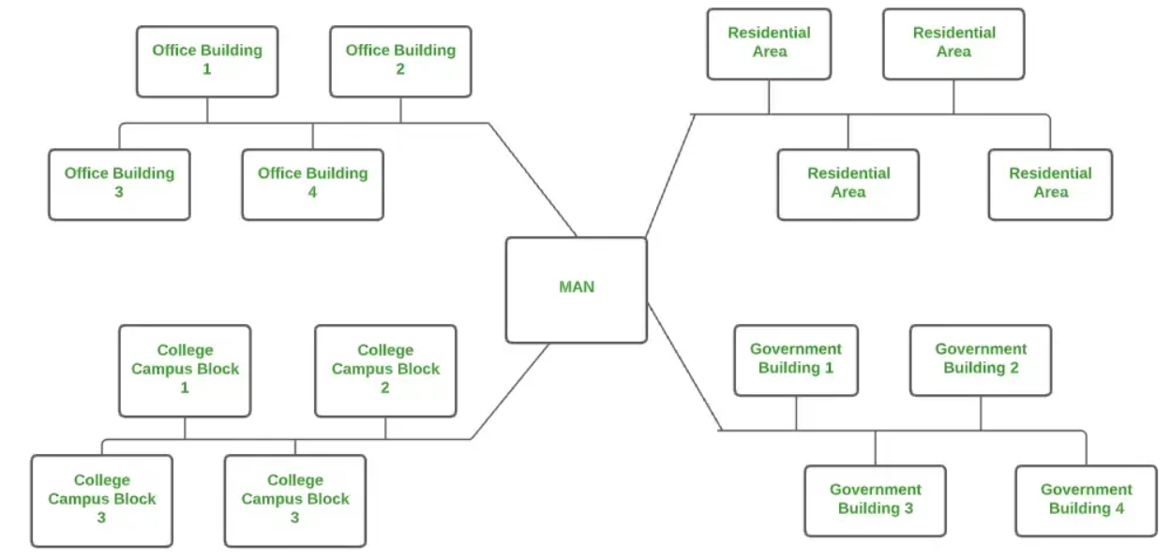
Types of Networks Classified by size/geographical area
Also (we won’t talk about this though):
MAN: Metropolitan Area Network
A MAN connects multiple networks within a city or metropolitan region.
Coverage Range: City or large town
Key Technologies: Fiber Optics, Microwave, Metro Ethernet
Real-World Example: City-wide ISP network
When It Is Used: To provide high-speed connectivity across a city

Slide 7
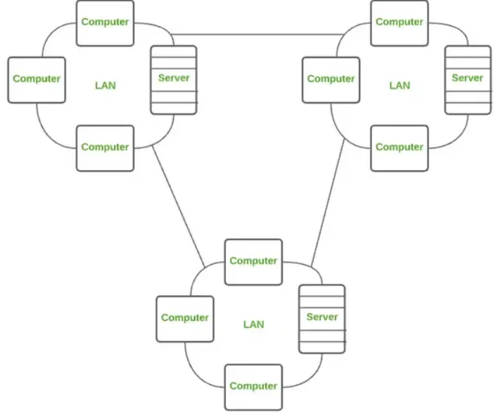
Types of Networks Classified by size/geographical area
WAN: Wide Area Network (“Long haul network”)
Widespread geographically, connects networks over large geographical areas such as countries – Lower speed
Typically connections of multiple LANs
Key Technologies: Leased lines, Satellite links, Internet
Real-World Example: The Internet
When It Is Used: To enable long-distance and global communication

Slide 8

The Internet
A collection of LANs
Switch/Hub
Basic idea: Network of networks
Internet (protocol) vs. “The Internet”

Slide 9

The Internet
A collection of LANs
Router
Switch/Hub
Basic idea: Network of networks
Internet (protocol) vs. “The Internet”

Slide 10
Some Internet History
ARPA (Advanced Research Projects Agency) experiment to test ideas of “packet switched networks”
1969: First node goes on-line (UCLA)
1970’s: Maturing and apps (e-mail in 1972)
1980’s: Widespread in academic, military, and research communities
1985: NSFNET
1990’s: The web and privatization

Slide 11
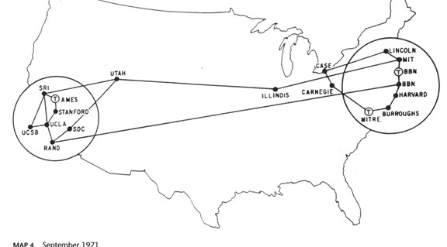
The ARPANET in 1971

Slide 12
Packet Switching
A key concept from the ARPANET
A B C D E F G H I J K L M N O P
A B C D
E F G H
I J K L
M N O P
Packet size determined by MTU (Maximum Transmission Unit)
Each packet sent independently
Different pieces can be routed separately in a series of hops
If MTU exceeded for hop, can break down further (fragments)
Not dependent on a fixed “switched” connection, so can “re-route” easily to avoid trouble spots
Everything in the open, visible, and independent
Good analogy: postcards

Slide 13
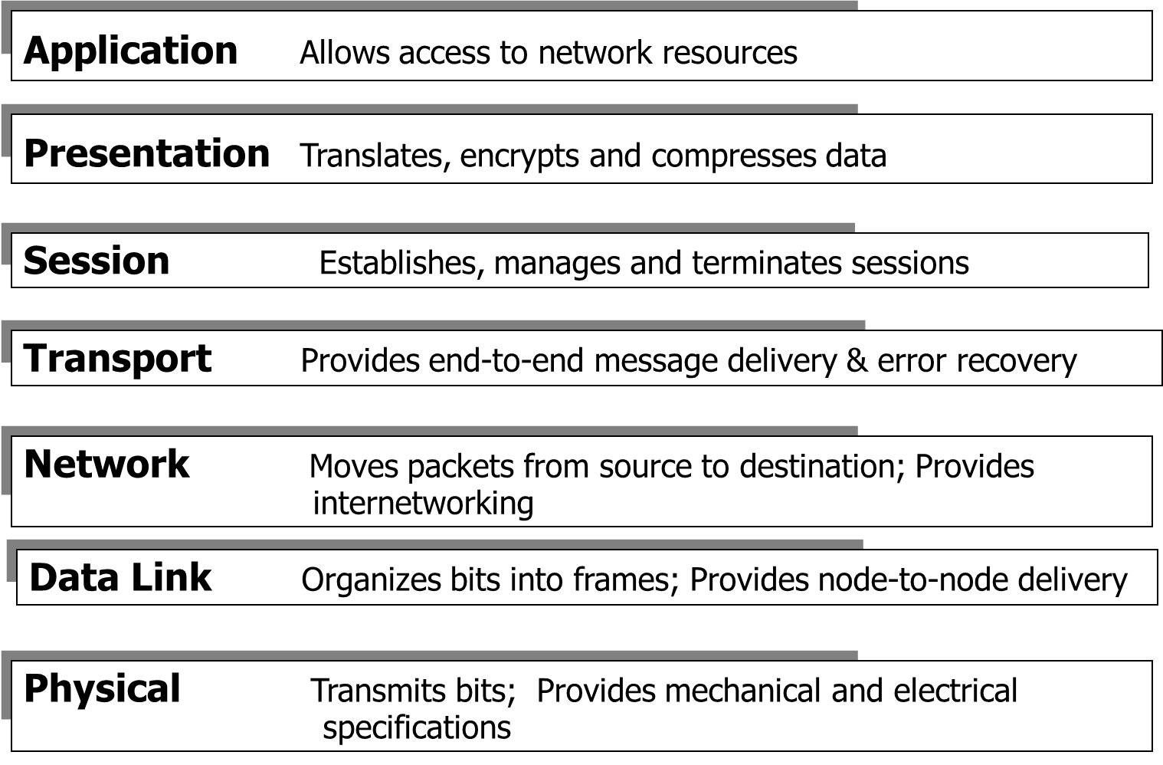
Network Layers
OSI and Internet Models
Layer
7
6
5
4
3
2
1
What the user interacts with
Establishes a logical connection；
Ensures that data is delivered accurately；
Detects errors；
Controls the data transmission rate
Deals with MAC addresses and frames.
OSI Model

Slide 14
Network Layers
OSI and Internet Models
Layer
7
6
5
4
3
2
1
Application: HTTP, FTP, SMTP (E-mail)…
Transport: TCP, UDP
Network: IP (Internet Protocol)
Data Link + Physical
OSI Model
IP (or TCP/IP or Internet) Model

Slide 15
Network Layers
OSI and Internet Models
Layer
7
6
5
4
3
2
1
Application: HTTP, FTP, SMTP (E-mail)…
Transport: TCP, UDP
Network: IP (Internet Protocol)
Data Link + Physical
OSI Model
IP (or TCP/IP or Internet) Model
Next: We look at issues and vulnerabilities with each layer.

Slide 16
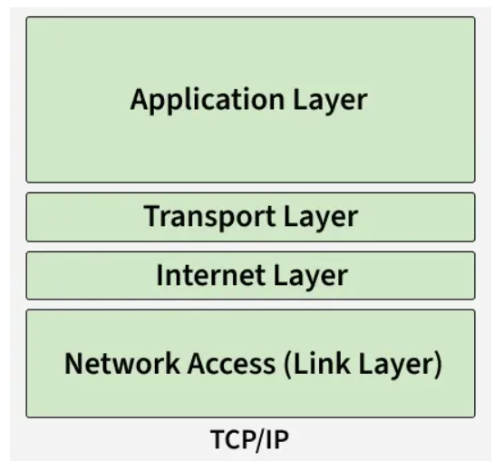
First up: Physical and Link Layers

Slide 17
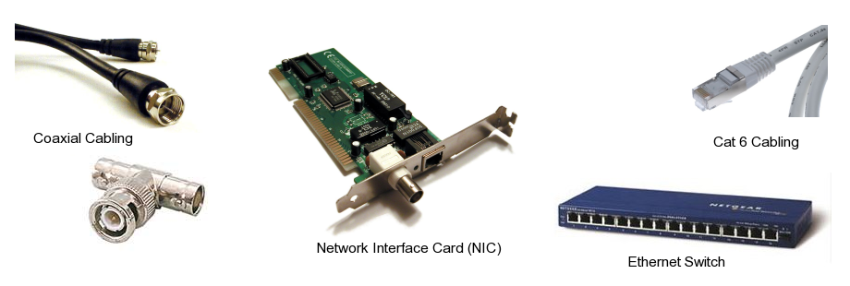
Transmission Media Layers 1 and 2
How do the bits actually travel? (Physical Layer)
Wires
LAN/Ethernet: Twisted pair or Coaxial cable
Advantages: Very fast (Cat 5/5e/6 can do up to 1Gbps)
Drawbacks: Signal attenuation limits high-speed distance
Be careful about crosstalk, esp. in tight cable bundles!

Slide 18
Transmission Media – Cont’d
Optical Fiber
Light inside glass fibers instead of electrical signals
Advantages:
Very fast (10 Gbps or more)
Less signal attenuation than copper
Less interference and harder to tap (less signal leakage)
Disadvantages:
Interfaces not common for end-users
Used mostly in backbones and long distance
FDDI: Fiber-Distributed Data Interfaces
Ethernet over fiber (up to 10 Gbps)
Becoming more common to residential endpoints
Verizon FiOS
Google Fiber
AT&T Fiber (AT&T U-verse)

Slide 19
Transmission Media – Cont’d
Radio (Wireless)
802.11a/b/g (WiFi) for LAN use
Bluetooth – fast and cheap, but short range
LTE and 802.16 (WiMax) – emerging for wide area
Advantages: Convenience and reasonable speed
Drawbacks: Broadcasting to the world!
Encryption helps, but WEP is broken (WPA2 / 802.11i much better)
Important to configure securely
Jamming and signal blocking not difficult
Security considerations: directional signals, spread spectrum, …
Microwave
Line-of-sight transmission
Limited by obstacles and curvature of earth
But signals can be “bounced”

Slide 20
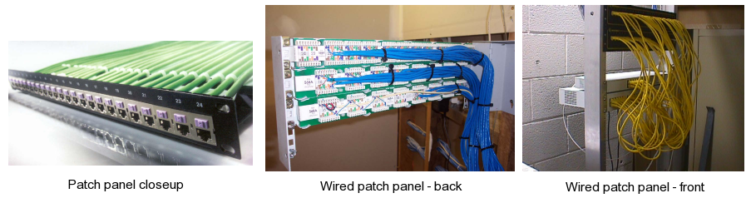
Typical Building/Facility Ethernet
Fixed outlets wired to patch panel
Located in “wiring closet” or server room
Patch panel to switch
Switch to router (higher layer issue!)

Slide 21
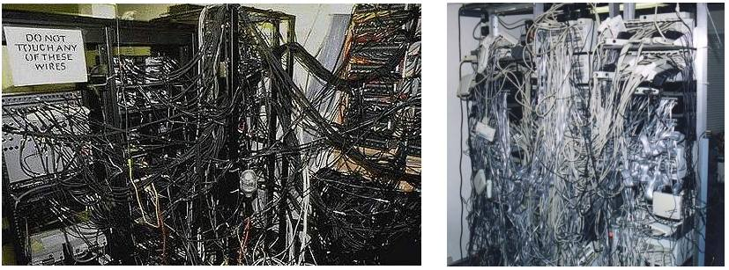
Atypical Building/Facility Ethernet
Unfortunately, maybe not as “atypical” as it should be...
Neatness counts!
Your wiring might not be on display, but…
… would you want to have to maintain either of these?

Slide 22
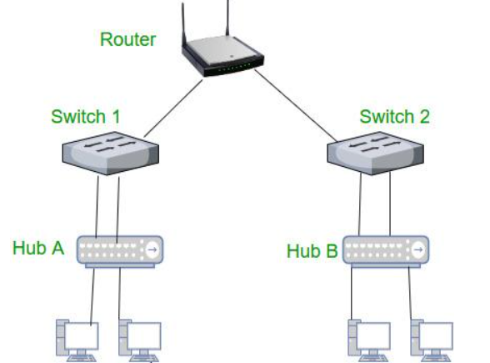
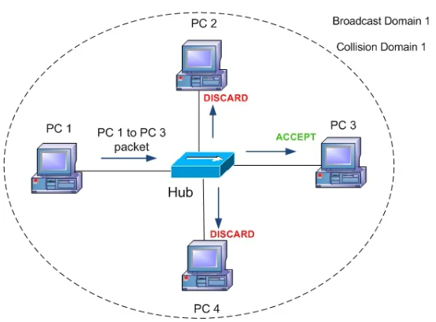
Link Layer
Ethernet

Slide 23
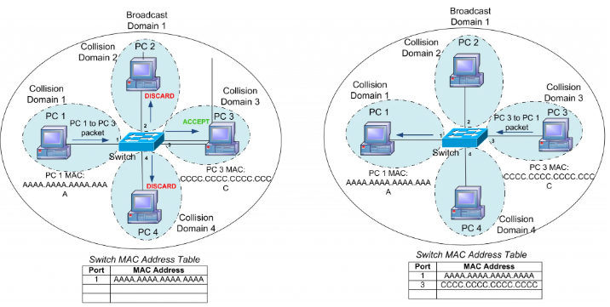
Link Layer
Ethernet
Has a "MAC table" that tracks which addresses are connected to which physical port

Slide 24
Ethernet MAC Addresses
MAC = "Media Access Control"
Example MAC address: 00:1b:21:79:6b:52
Every network interface must have a unique address
(Common mistake: Thinking addresses are for computers, rather than interfaces)
How do manufacturers ensure addresses are unique?
00:1b:21
:
79:6b:52
Assigned to one manufacturer
Manufacturer chooses

Slide 25
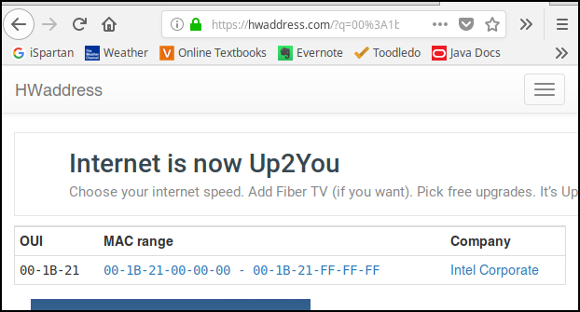
Manufacturer for given MAC prefix
First 24 bits of MAC address are assigned to a manufacturer
Several web sites will look up a MAC prefix and tell you the manufacturer
Example lookup using
http://hwaddress.com/
So MAC address in our previous example is from a network card manufactured by Intel.

Slide 26
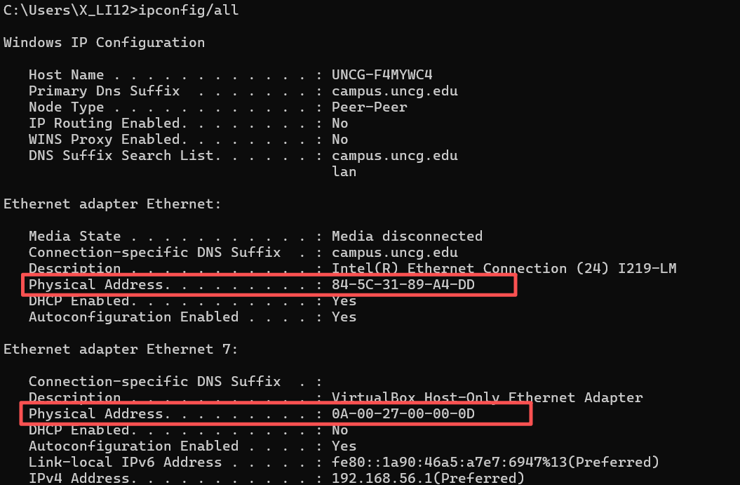
MAC Addresses
Finding MAC address in Windows 11
"Physical Address" is MAC address

Slide 27
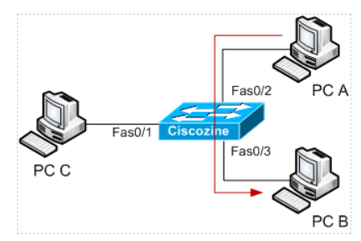
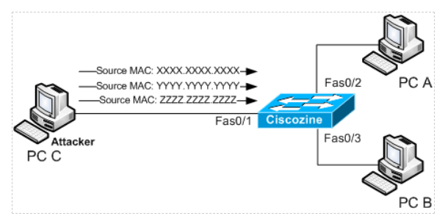
Link Layer Threats and Vulnerabilities MAC Flooding Attack
The attacker (in this instance PC C) floods the switch with packets, each with different source MAC address.
When PC A sends a packet to PC B, PC C does not view packet sent between PC A and PC B

Slide 28
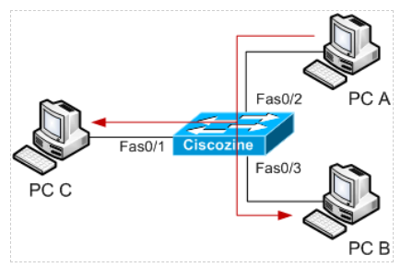
Link Layer Threats and Vulnerabilities MAC Flooding Attack
If the memory where the MAC addresses are stored is full, the switch works like a hub

Slide 29
Link Layer Threats and Vulnerabilities MAC Flooding Attack
There are three types of secure MAC addresses:
Static secure MAC addresses
Manually configured, stored in the address table, and added to the switch running configuration.
Dynamic secure MAC addresses
These are dynamically learned, stored only in the address table, and removed when the switch restarts.
Sticky secure MAC addresses
Dynamically learned or manually configured, stored in the address table, and added to the running configuration. If these addresses are saved in the configuration file, the interface does not need to dynamically relearn them when the switch restarts.

Slide 30
Next: Network Layer

Slide 31
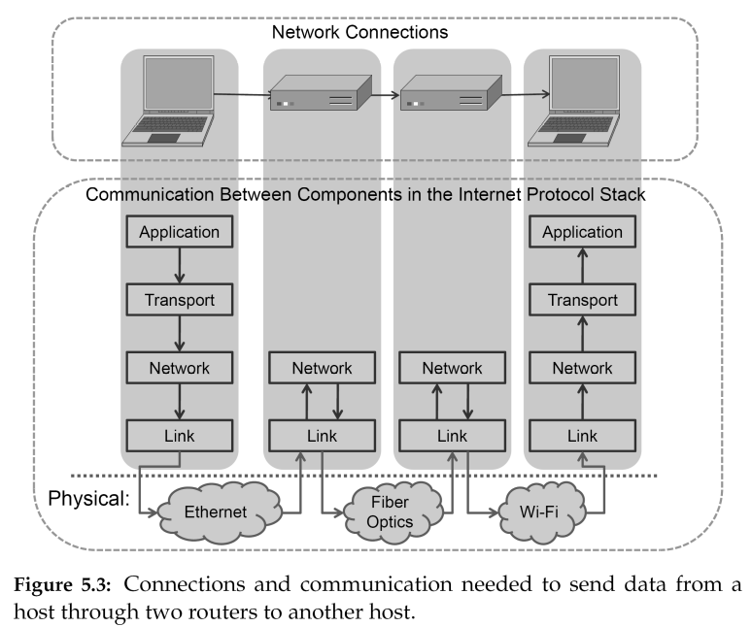
Network Layer Overview
Purpose: Get data from one IP address to another
Machine-to-machine issues (no knowledge of applications)
Intermediate hops only look (usually!) at network layer
Exceptions:
“Traffic shaping”
Security monitoring
Proxies
technically 2 connections

Slide 32
Network Layer Issues IP Packets
0
7
8 15
16 31
Vers: 4
IHL
ToS
Total Length
ID (for fragmentation)
Flags
Fragment Offset
TTL = “Time to Live”
TTL
Protocol
Header Checksum
IP Source Address
IP Destination Address
Common
Protocols
1 = ICMP
6 = TCP
17 = UDP
Options (usually empty)
Data
Everything is “just bits” being transmitted
Can all be tampered with!
Header checksum is not cryptographic – for detecting transmission errors, not tampering

Slide 33
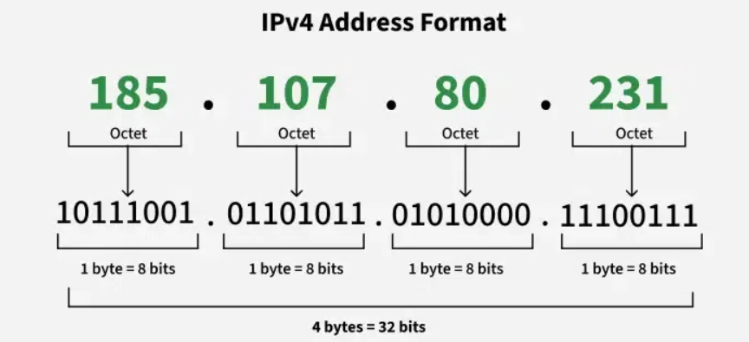
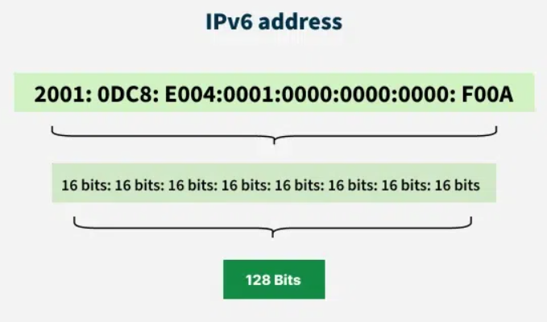
Internet Addresses
IP = "Internet Protocol"
IPv4 addresses look like aaa.bbb.ccc.ddd
Each of the 4 numbers is in the range 0..255 (1 byte)
IPv6 addresses look like xxxx:xxxx:xxxx:... (all hexadecimal digits)

Slide 34
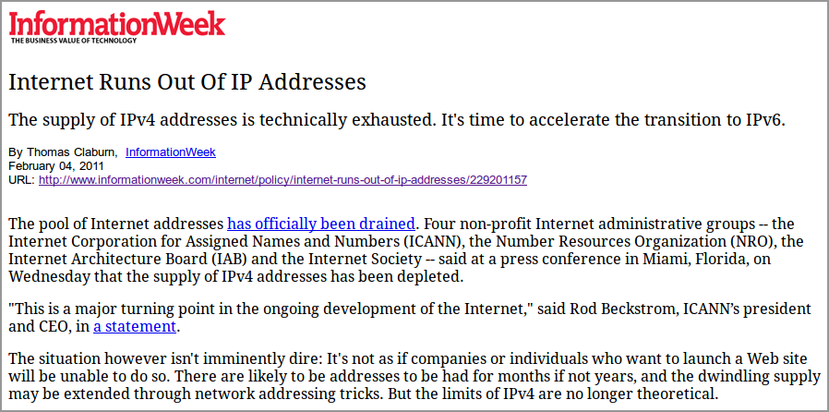
Internet Addresses
Size of IPv4 addresses:
4 numbers, each one byte (8 bits)
Therefore, addresses are 32 bits
Why important? Means at most 2³² different IP addresses.
2³² is about 4 billion - what happens when we run out of IP addresses???
Oops - we are out of IP addresses!
Important points:
These addresses are "IPv4" (or IP version 4) addresses
With "IPv6" (version 6) - addresses are 128 bits
128 bits gives over 10³⁸ addresses - we won't run out of these!

Slide 35
Internet Addresses
IP address examples (simplified…):
All in UNCG SPAN Lab look like 152.13.218.???
General hosts in Petty Building look like 152.13.136.???
All on UNCG campus look like 152.13.???.???
All on North Carolina Research and Education Network like 152.?.?.?
So: All in the same LAN agree on the first three numbers
All on the same campus agree on the first two numbers
All in the same multi-campus network (NCREN here) agree on first number
Hierarchical addressing allows us to route messages between LANs
Note: This example is somewhat simplified (buildings, campuses, etc.). In reality things don't always match up to specific numbers in the IP address, but the ideas are similar!
More on how routing works next time… but first, what about local delivery?

Slide 36
Local Delivery
IP to Ethernet mapping using ARP
ARP = "Address Resolution Protocol"
Example:
152.13.136.18 wants to send "hello" to 152.13.136.25
Important points
Recognizes a "local connection" since only last number differs (technically: use netmask)
Problem: Local communication uses Ethernet MAC addresses

Slide 37
Local Delivery
IP to Ethernet mapping using ARP
ARP = "Address Resolution Protocol"
Example:
152.13.136.18 wants to send "hello" to 152.13.136.25
Important points
Recognizes a "local connection" since only last number differs (technically: use netmask)
Problem: Local communication uses Ethernet MAC addresses
MAC 00:33:9a:55:29:19
IP addr 152.13.136.33
To ff:ff:ff:ff:ff:ff (broadcast)
Who has 152.13.136.25?
Switch
MAC 00:1b:12:51:c3:ba
IP addr 152.13.136.18
MAC 03:2b:91:ac:52:9a
IP addr 152.13.136.21
MAC 00:1b:5a:31:14:a2
IP addr 152.13.136.25

Slide 38
Local Delivery
IP to Ethernet mapping using ARP
ARP = "Address Resolution Protocol"
Example:
152.13.136.18 wants to send "hello" to 152.13.136.25
Important points
Recognizes a "local connection" since only last number differs (technically: use netmask)
Problem: Local communication uses Ethernet MAC addresses
MAC 00:33:9a:55:29:19
IP addr 152.13.136.33
Switch
To: 00:1b:12:51:c3:ba
I have 152.13.136.25
at 00:1b:5a:31:14:a2
MAC 00:1b:12:51:c3:ba
IP addr 152.13.136.18
MAC 03:2b:91:ac:52:9a
IP addr 152.13.136.21
MAC 00:1b:5a:31:14:a2
IP addr 152.13.136.25

Slide 39
Local Delivery
IP to Ethernet mapping using ARP
ARP = "Address Resolution Protocol"
Example:
152.13.136.18 wants to send "hello" to 152.13.136.25
Important points
Recognizes a "local connection" since only last number differs (technically: use netmask)
Problem: Local communication uses Ethernet MAC addresses
MAC 00:33:9a:55:29:19
IP addr 152.13.136.33
To 00:1b:5a:31:14:a2
"hello"
Switch
MAC 00:1b:12:51:c3:ba
IP addr 152.13.136.18
MAC 03:2b:91:ac:52:9a
IP addr 152.13.136.21
MAC 00:1b:5a:31:14:a2
IP addr 152.13.136.25

Slide 40
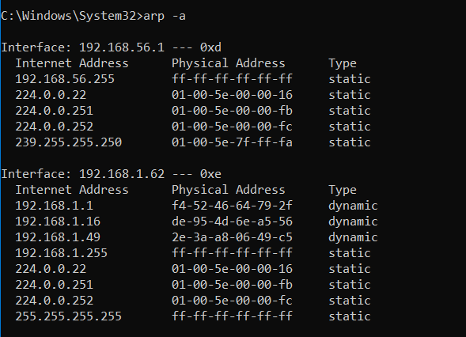
When ARP goes bad: ARP Spoofing
Performance: Hosts keep an “ARP Table” of known IP-to-MAC mappings
Doesn’t have to ask if MAC address known
Updates table with each “I have a.b.c.d” message
Expires mappings regularly (in case IP moves)
In Windows: “arp –a”

Slide 41
When ARP goes bad: ARP Spoofing
ARP spoofing: To sniff on a switched Ethernet
Attacker (on same LAN) sends out “I have a.b.c.d” messages for target machine (or all machines!)
Packets then sent to the attacker rather than the destination
Attacker can then forward packets so no disruption – just monitoring

Slide 42
ARP Spoofing Countermeasures
Static ARP tables
Sensitive subnets should use static ARP tables
Mappings don’t expire
Mappings are hard-coded to be genuine by the administrator
Not perfect: MAC address spoofing still possible!
Possible future directions:
A better solution is still an unresolved research issue
Some suggest authenticated ARP
Uses digital signatures (PK Crypto), so slow – and ARP needs to be very low overhead!

Slide 43
Subnet-to-subnet Communication Gateways and Routers
Router “lives on” multiple subnets
Local address on each
Can be more than 2 NICs / subnets
Routing tables say what goes where
See with “/sbin/route” in Linux/Unix
See with “route print” in Windows
129.12.60.0/23
subnet
129.12.61.1
Router
Sample simplified host routing table:
72.1.19.53
Destination Gateway Genmask Iface
129.12.60.0 0.0.0.0 255.255.254.0 eth0
0.0.0.0 129.12.61.1 0.0.0.0 eth0
Sample simplified router routing table:
72.1.19.0/24
subnet
Destination Gateway Genmask Iface
129.12.60.0 0.0.0.0 255.255.254.0 eth1
72.1.19.0 0.0.0.0 255.255.255.0 eth0
0.0.0.0 72.1.19.2 0.0.0.0 eth0

Slide 44
Network Layer Attacks
Attack type 1: Put invalid data in fields
Example 1: Ping of Death
“Too large” ping packet crashes machine
Example 2: LAND Attack
Specially crafted packet with both source and destination set to victim address, with fields that make machine lock up
Example 3: Jolt Attack (and Teardrop)
Invalid fragmentation of packets that destination can’t reassemble, so machine freezes waiting for more
Attack type 2: Overwhelm network bandwidth
Example: Ping flood
Send rapid-fire “echo request” ICMP packets

Slide 45
Network Layer Attacks
Combining address spoofing with flooding
Smurf Attack (Simplified - just spoofing to hide attacker)
Fake ping packet
with src 209.12.17.35
and dest 123.45.67.89
Intermediary
123.45.67.89
Ping response to
Victim
Attacker
24.3.29.123
Victim
209.12.17.35

Slide 46
Network Layer Attacks
Combining address spoofing with flooding
Smurf Attack (DoS amplification)
Fake ping packet
with src 209.12.17.35
and dest 123.45.67.255
Many (up to 254) ping
responses to Victim
Intermediaries
123.45.67.1
123.45.67.2
123.45.67.3
…
Attacker
24.3.29.123
Victim
209.12.17.35

Slide 47
Network Layer Attacks
Combining address spoofing with flooding
Smurf Attack (DoS amplification)
Fake ping packet
with src 209.12.17.35
and dest 123.45.67.255
Many (up to 254) ping
responses to Victim
Intermediaries
123.45.67.1
123.45.67.2
123.45.67.3
…
Attacker
24.3.29.123
Victim
209.12.17.35
Works particularly well when Attacker-Intermediaries connection
is lower bandwidth than Intermediaries-Victim

Slide 48
IP Spoofing Countermeasures
Filter out broadcast messages at gateway
Doesn’t work if intermediary inside border!
In general: Filter out LAN-only messages across border
Egress filtering
Only let out packets with appropriate source addresses
Doesn’t stop you from being an intermediary or a victim – think of it as “being a good netizen”

